Slide 1
Roll No: BSCS17-27 Name: Abdul Hakeem Session: 2017-2021 Project Supervisor: Dr. Minhaj Ahmad Khan

Slide 2
Project Title
Online Service Management System

Slide 3
Project Introduction
Online Service Management System is a project which aims in developing a Online Application to maintain all the daily work of Service Centre.
This project has many features which are generally not available in normal Online Service Management Systems like Product/Parts Records, Issue Customer Bill etc.
It also has a facility of admin login through which the admin can monitor the whole system.
This System can be used to search for Assign Work, Add/Remove Technician, Add/Remove Products etc.
The Admin after logging into his account can generate various reports such as Product Sell Report and Service/Work Report.
Overall this project of ours is being developed to help the Service Centre to maintain the Service Centre in the best way possible and also reduce the human efforts.

Slide 4
Objectives
Practically
Efficiency
Cost
Portability
Security

Slide 5
DFD 0 Level
Check status
Requester
Online Service Managment System
Report
Submit request
Admin
Approval

Slide 6
DFD 1 Level
Requester
Admin
Assign Work
retrieve
update
Authentic Status
requester_tb
retrieve
update
assignwork_tb
Authentic
Authentic Status
Authentic Status
Customer
View info
admin_tb/requ_tb
Authentic Status
update
retrieve
Authentic Status
customer_tb
Requester
Authentic Status
Logout
Product sell
update
Report
Submit request
retrieve
assets
view
submit
submit_request

Slide 7
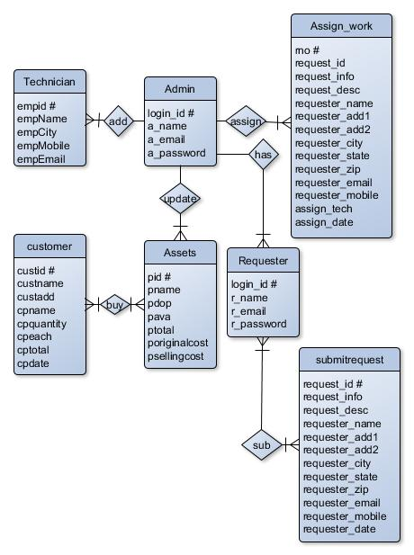
ER Diagram

Slide 8
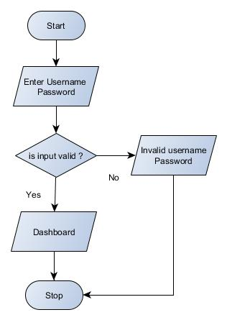
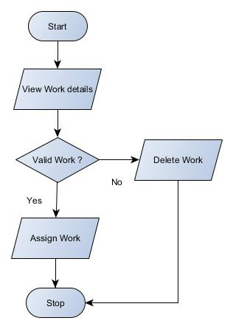
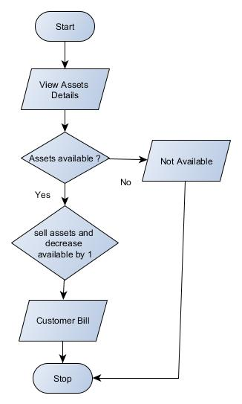
Flow Chart
Login
Assign Work
Sell Product

Slide 9
Module Sand
Home
Services
Registration
Contact
Login
User Panel
Profile
Submit Request
Service Status
Change Password
Logout
Admin Login
Admin Panel
Dashboard
Work Order
Requests
Assets
Technician
Requester
Sell Report
Work Order
Change Password
Logout

Slide 10
Input/Output Module
Input to the Project
Requester Registration
Service Request
Service Status
Assign Work
Assets
Output to the Project
Work Order
Assets List
Technician List
Requester List
Sell Report
Work Report

Slide 11
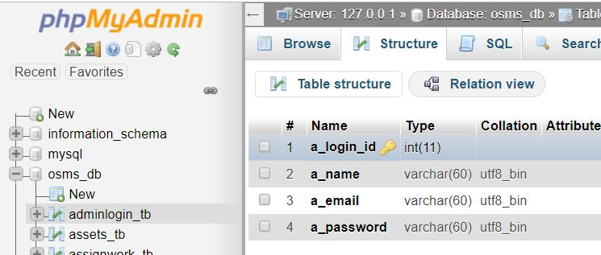
Data Dictionary
Table Name: adminlogin_tb
Attribute | Data Type | Description
a_login_id # | int | Stores login id (Automatically Generated)
a_name | varchar(60) | Stores Name
a_email | varchar(60) | Store Email
a_password | varchar(60) | Store Password

Slide 12
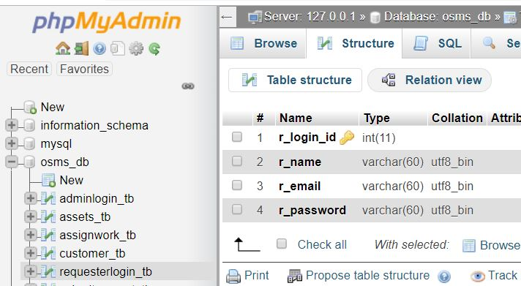
Data Dictionary
Continue
Table Name: requesterlogin_tb
Attribute | Data Type | Description
r_login_id # | int | Stores login id (Automatically Generated)
r_name | varchar(60) | Stores Name
r_email | varchar(60) | Store Email
r_password | varchar(60) | Store Password

Slide 13
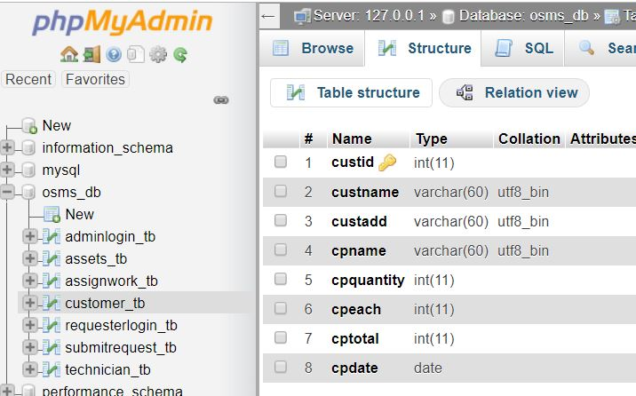
Continue
Table Name: customer_tb
Attributes | Data Type | Description
custid # | int | Customer ID (Automatically Generated)
custname | varchar(60) | Customer Name
custadd | varchar(60) | Customer Address
cpname | varchar(60) | Product Name
cpquantity | int | Product Quantity
cpeach | int | Each Quantity Price
cptotal | int | Total Price
cpdate | date | Selling Date

Slide 14
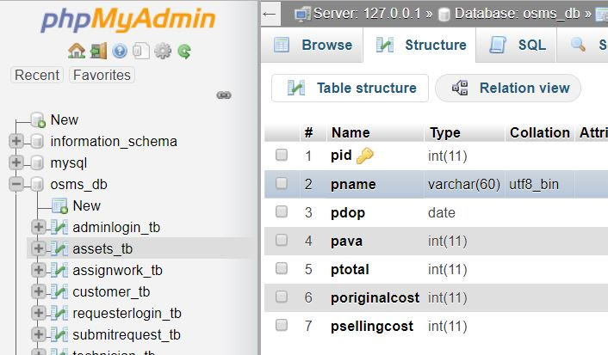
Continue
Table Name: assets_tb
Attributes | Data Type | Description
pid # | int | Product ID (Automatically Generated)
pname | varchar(60) | Product Name
pdop | date | Product Date
pava | int | Number of Available Product
ptotal | int | Number of Total Product
poriginalcost | int | Product Original Cost
psellingcost | int | Product Selling Price

Slide 15
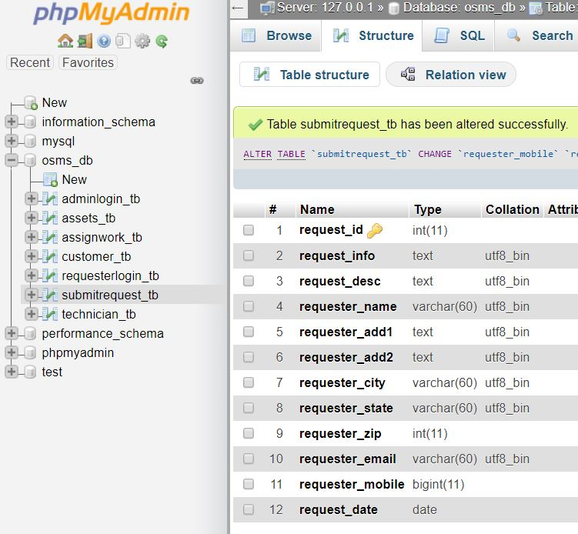
Continue
Table Name: submitrequest_tb
Attributes | Data Type | Description
request_id # | int | Request ID (Automatically Generated)
request_info | text | Request Info
request_desc | text | Request Description
requester_name | varchar(60) | Requester Name
requester_add1 | text | Requester Address Line 1
requester_add2 | text | Requester Address Line 2
requester_city | varchar(60) | Requester City
requester_state | varchar(60) | Requester State
requester_zip | int | Requester Zip
requester_email | varchar(60) | Requester Email
requester_mobile | bigint | Requester Mobile
request_date | date | Request Date

Slide 16
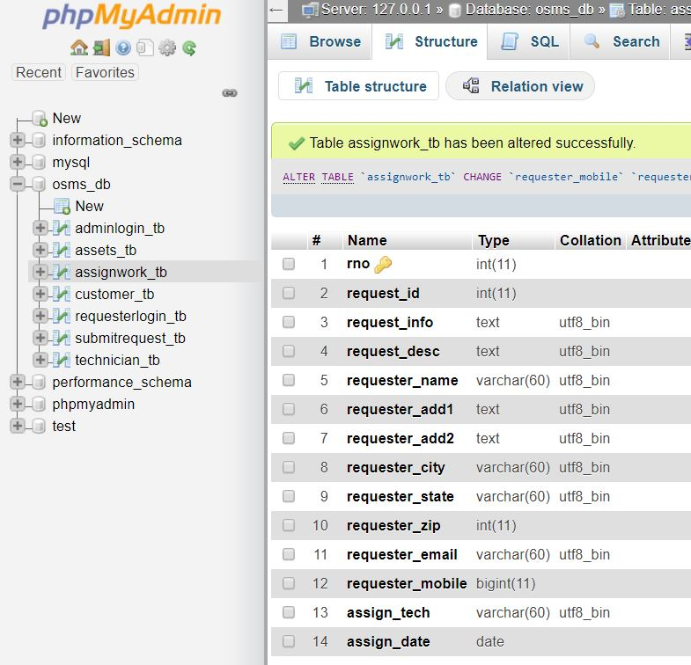
Continue
Table Name: assignwork_tb
Attributes | Data Type | Description
rno # | int | Request Number (Automatically Generated)
request_id | int | Request ID
request_info | text | Request Info
request_desc | text | Request Description
requester_name | varchar(60) | Requester Name
requester_add1 | text | Requester Address Line 1
requester_add2 | text | Requester Address Line 2
requester_city | varchar(60) | Requester City
requester_state | varchar(60) | Requester State
requester_zip | int | Requester Zip
requester_email | varchar(60) | Requester Email
requester_mobile | bigint | Requester Mobile
assign_tech | varchar(60) | Assign Technician Name
assign_date | date | Assigned Date

Slide 17
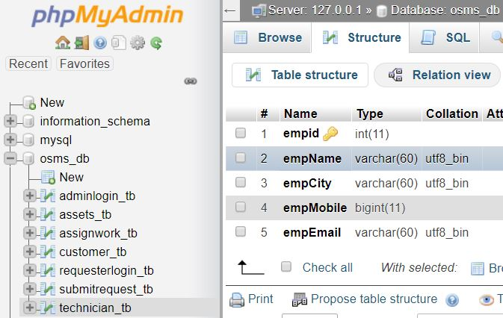
Continue
Table Name: technician_tb
Attributes | Data Type | Description
empid # | int | Employee ID (Automatically Generated)
empName | varchar(60) | Employee Name
empCity | varchar(60) | Employee City
empMobile | bigint | Employee Mobile Number
empEmail | varchar(60) | Employee Email ID

Slide 18
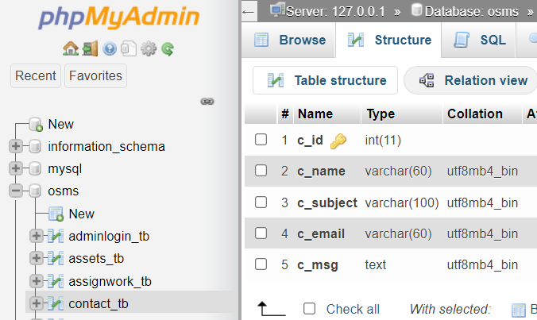
Continue
Table Name: contact_tb
Attributes | Data Type | Description
c_id | int | Contact Person ID
c_name | varchar(60) | Contact Person Name
c_subject | varchar(60) | Contact Person Subject
c_email | varchar(60) | Contact Person Email
c_msg | text | Contact Person Message

Slide 19
Languages
HTML
CSS
JavaScript
PHP

Slide 20
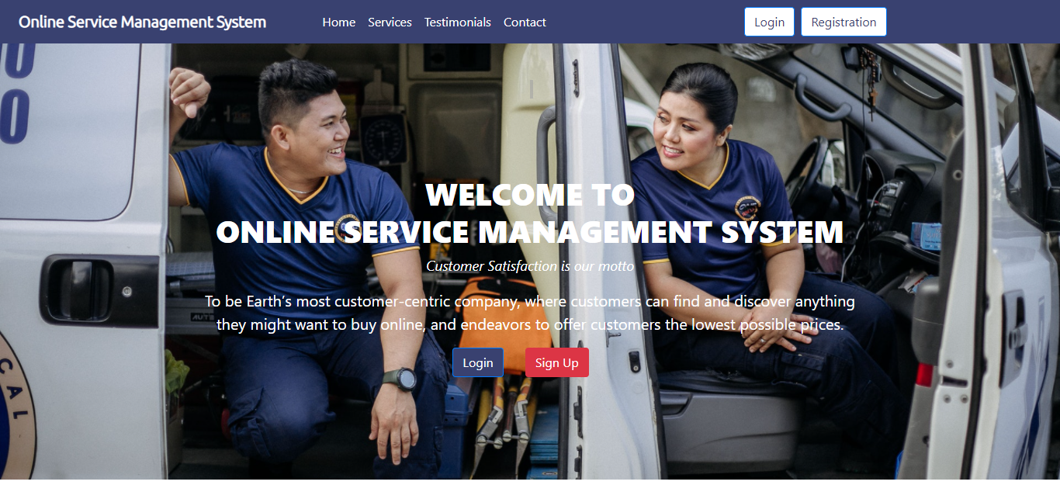
User Guide
Homepage

Slide 21
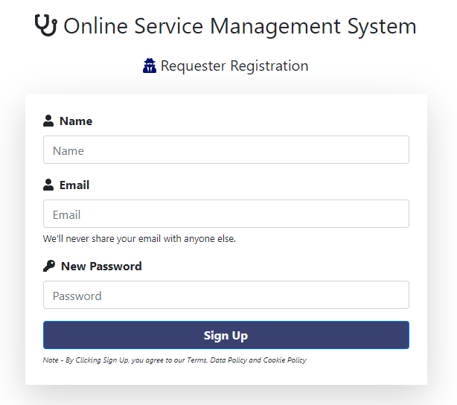
User Guide
Continue
Registration

Slide 22
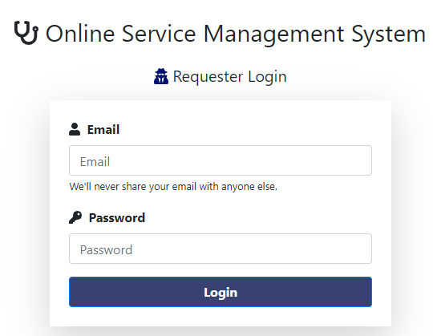
User Guide
Continue
Login

Slide 23
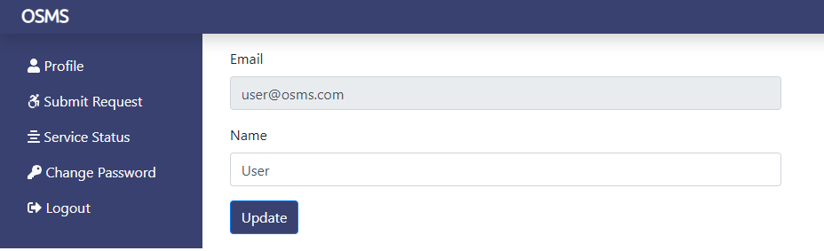
User Guide
Continue
Profile

Slide 24
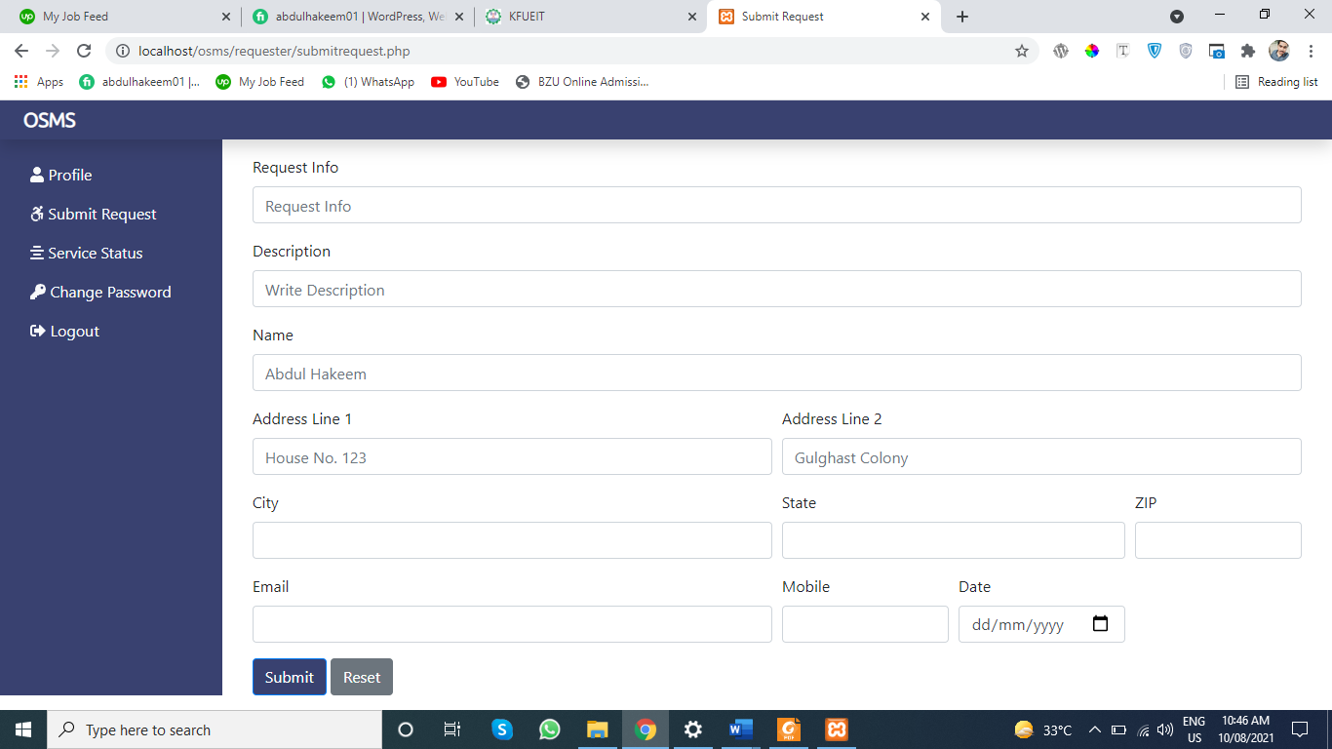
User Guide
Continue
Submit Request

Slide 25
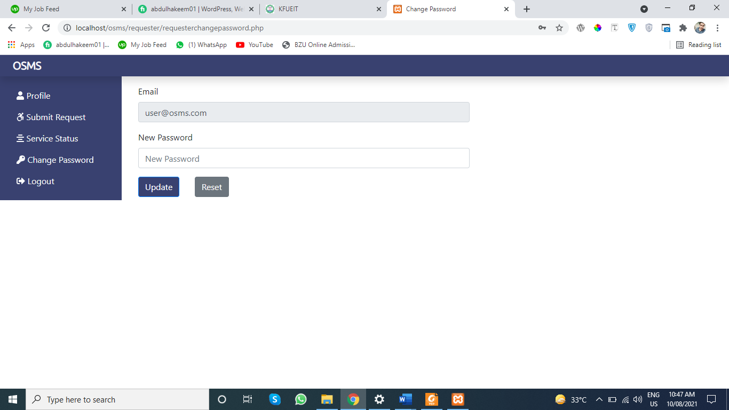
User Guide
Continue
Change Password

Slide 26
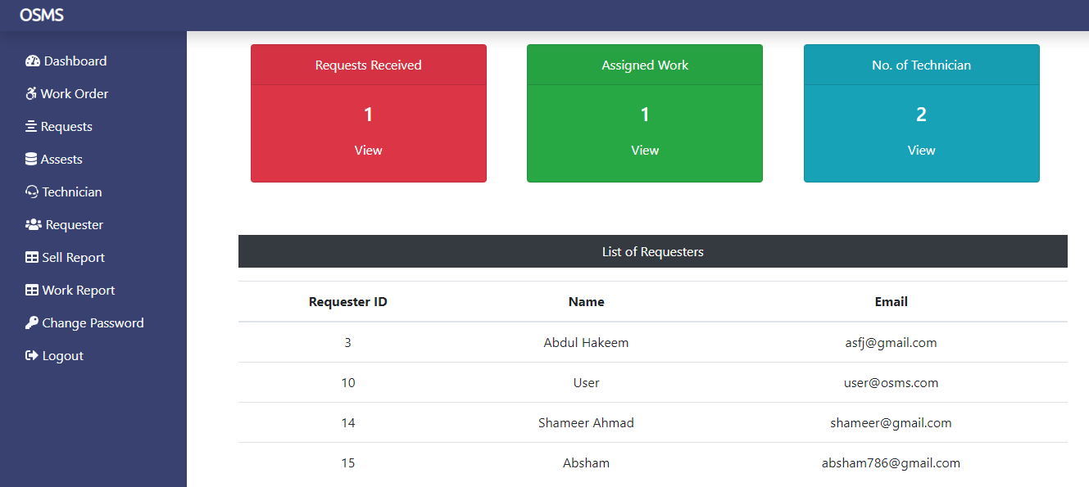
Admin’s Guide
Dashboard

Slide 27
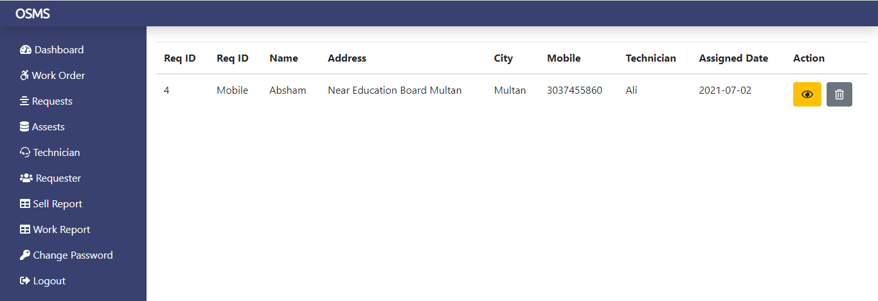
Admin’s Guide
Continue
Work Order

Slide 28
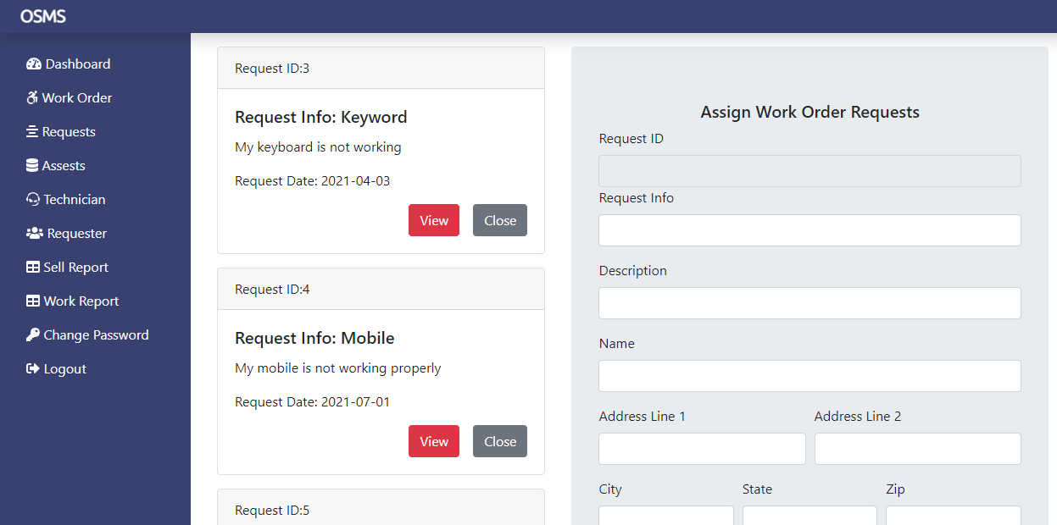
Admin’s Guide
Continue
Requests

Slide 29
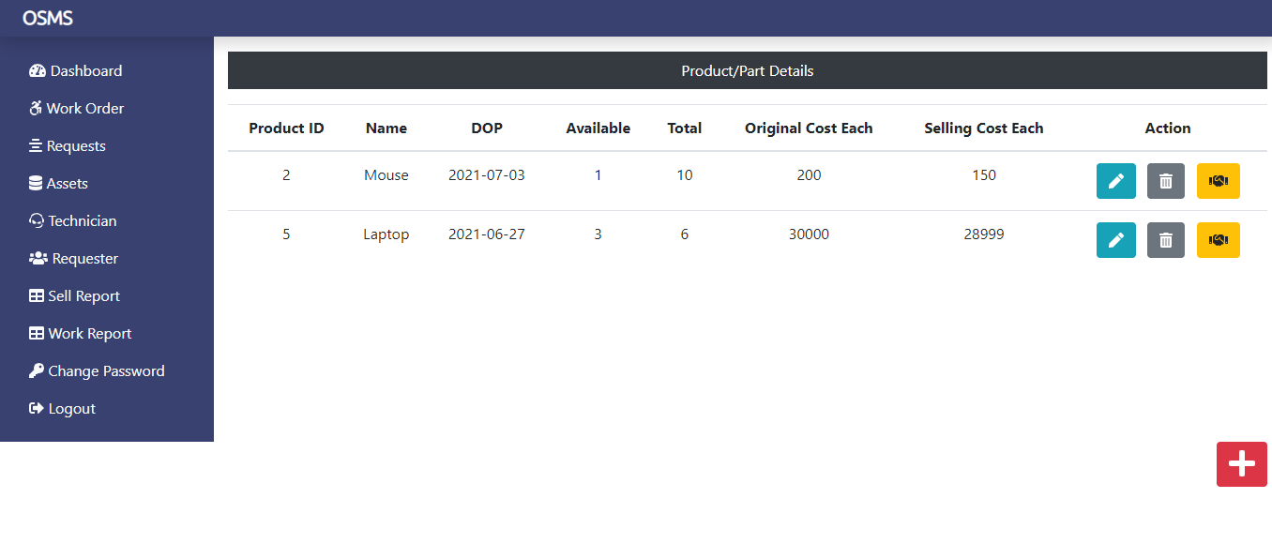
Admin’s Guide
Continue
Assets

Slide 30
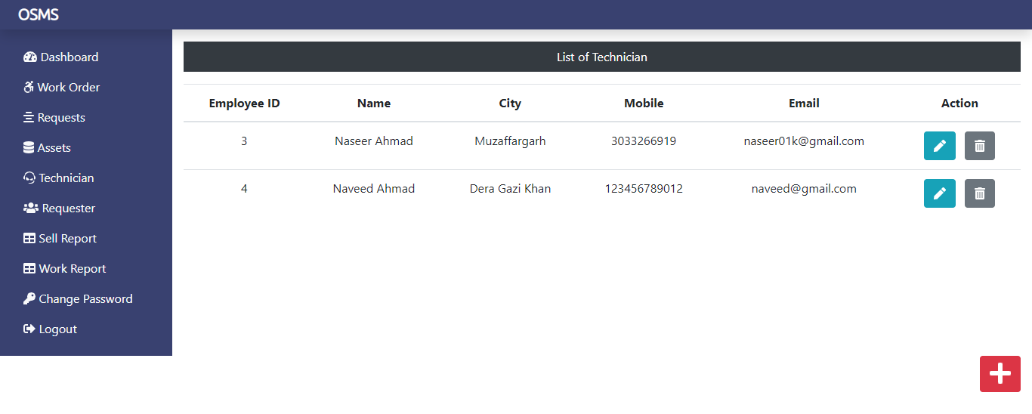
Admin’s Guide
Continue
Technician

Slide 31
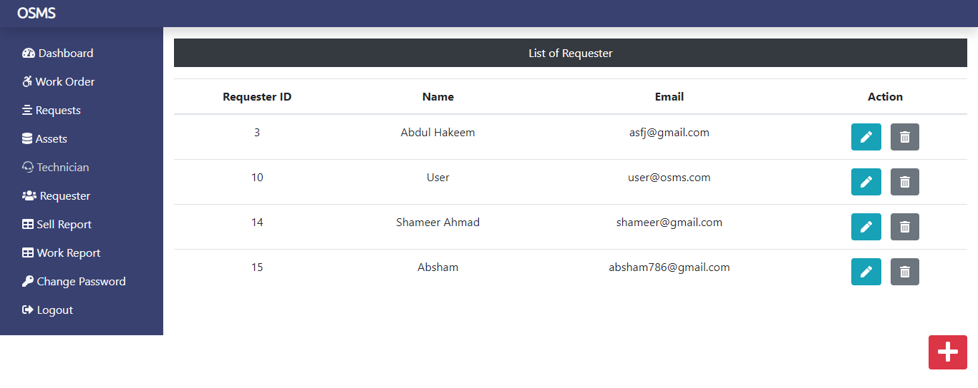
Admin’s Guide
Continue
Requester

Slide 32
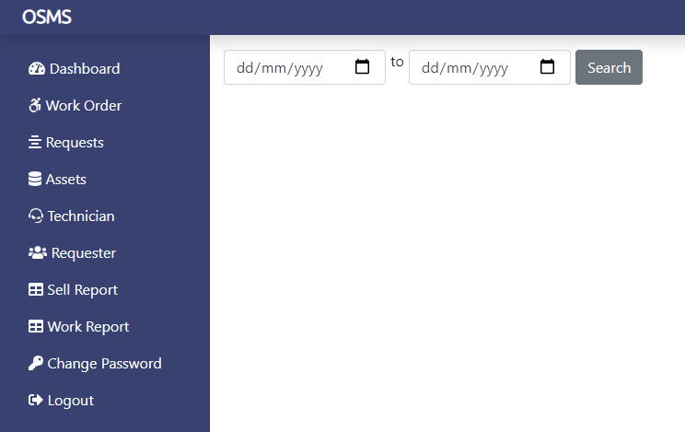
Admin’s Guide
Continue
Sell Report

Slide 33

Admin’s Guide
Continue
Work Report

Slide 34
Limitation
SMS alert facility is not available.
Portal is not SEO friendly
Registration Email Verification Not available
Risk unauthorized accessibility

Slide 35
Future Scope
The various things can be made it simple and user friendly. As by increasing some of the coding we can improve it functionality. online payment system is yet not integrated to the system which can be featured in the near future.
Till now it does not have the facility of back up the database. By as the next advancement we can make it able to bundle the backup facility so that one can perform operation based on previous records.
As the technology emerges, it is possible to upgrade the system and can be adaptable to desired environment.
Based on the future security issued, security can be improved using emerging technologies.

Slide 36
Thank You!

